Slide 1
ENGR 102 PROGRAMMING PRACTICE
WEEK 8

Slide 2
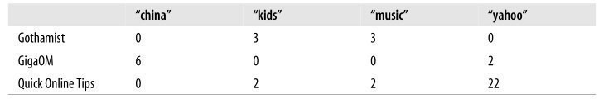

Play with H. Clustering
import clusters blognames, words, data = clusters.readfile('blogdata.txt') clust=clusters.hcluster(data) clusters.printclust(clust,labels=blognames)

Slide 3
Reading word matrix file
def readfile(filename): with open(filename) as f: lines = [line for line in f] # First line is the column titles colnames = lines[0].strip().split('\t')[1:] rownames = [] data = [] for line in lines[1:]: p = line.strip().split('\t') # First column in each row is the rowname rownames.append(p[0]) # The data for this row is the remainder of the row data.append([float(x) for x in p[1:]]) return rownames, colnames, data

Slide 4
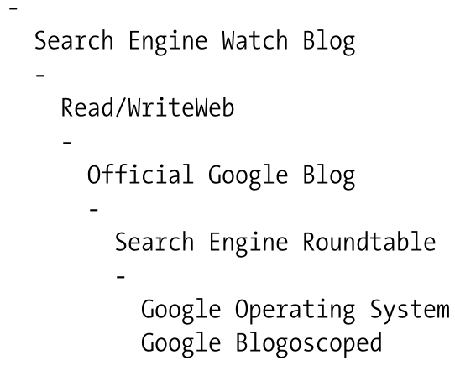
Viewing Clusters - printclust

Slide 5
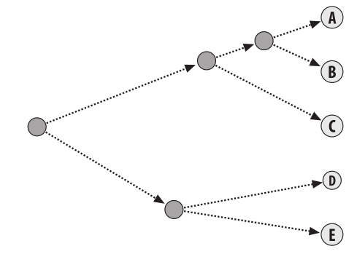
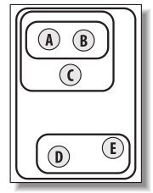
Visualizing Clusters - Dendograms

Slide 6
Visualizing Clusters – Drawing Dendograms
Install Pillow module
PyCharm (like any other module installation)
or
pip install Pillow

Slide 7
Play with Dendograms
import clusters blognames, words, data = clusters.readfile('blogdata.txt') clust=clusters.hcluster(data) clusters.printclust(clust,labels=blognames) clusters.drawdendrogram(clust, labels=blognames, jpeg = ‘cl.jpeg')

Slide 8
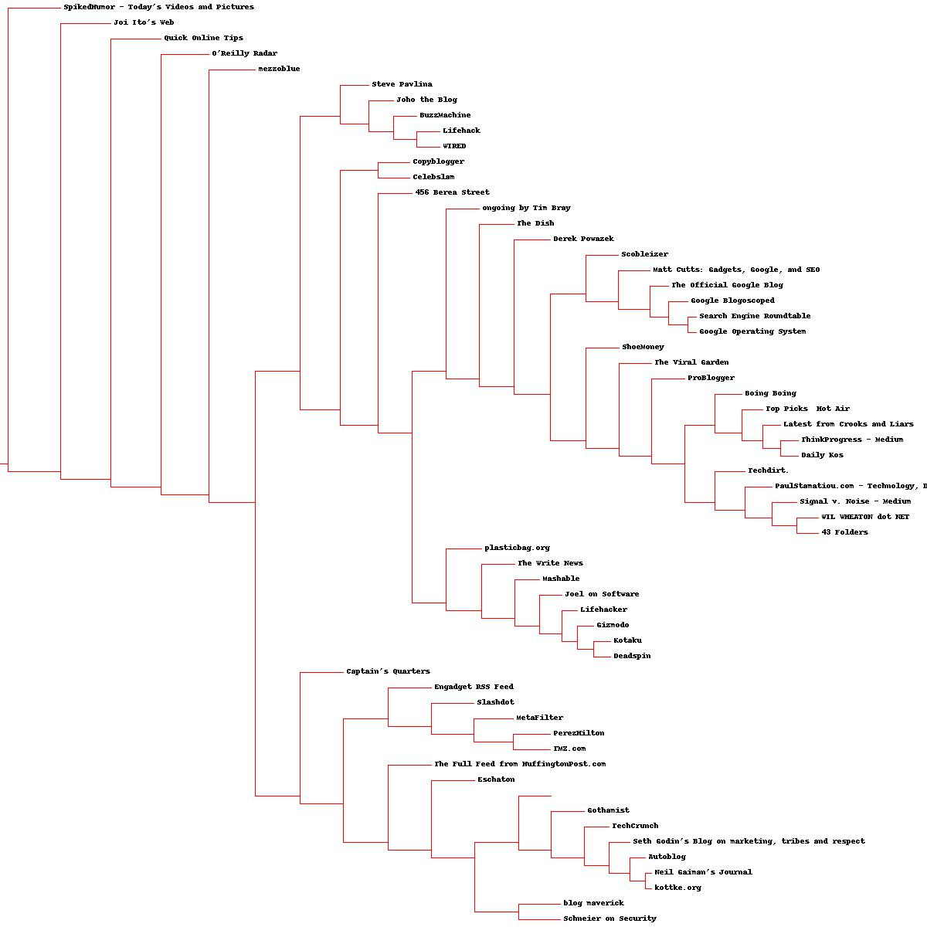

Slide 10
Think in Python!
Each cluster is either a point with two branches, or an endpoint associated with an actual data point.
Each cluster also contains the raw data for the endpoints and the merged data for points.

Slide 11
Cluster Object
class Bicluster: def __init__(self,vec,left=None,right=None,distance=0.0,id=None): self.left = left self.right = right self.vec = vec self.id = id self.distance = distance

Slide 12
Reading data points
def readfile(filename): with open(filename) as f: lines = [line for line in f] # First line is the column titles colnames = lines[0].strip().split('\t')[1:] rownames = [] data = [] for line in lines[1:]: p = line.strip().split('\t') # First column in each row is the rowname rownames.append(p[0]) # The data for this row is the remainder of the row data.append([float(x) for x in p[1:]]) return rownames, colnames, data

Slide 13
Clustering - I
def hcluster(rows, distance=pearson): distances = {} currentclustid = -1 # Clusters are initially just the rows clust = [Bicluster(rows[i], id = i) for i in range(len(rows))] while len(clust) > 1: lowestpair = (0, 1) closest = distance(clust[0].vec, clust[1].vec) # loop through every pair looking for the smallest distance for i in range(len(clust)): for j in range(i+1, len(clust)): # distances is the cache of distance calculations if (clust[i].id, clust[j].id) not in distances: distances[(clust[i].id, clust[j].id)]=
distance(clust[i].vec, clust[j].vec) d=distances[(clust[i].id, clust[j].id)] if d < closest: closest = d lowestpair = (i, j)

Slide 14
Clustering - II
# calculate the average of the two clusters mergevec=[(clust[lowestpair[0]].vec[i]+clust[lowestpair[1]].vec[i])/2 for i in range(len(clust[0].vec))] # create the new cluster newcluster = Bicluster(mergevec,
left=clust[lowestpair[0]], right=clust[lowestpair[1]], distance=closest,
id=currentclustid) # cluster ids that weren't in the original set are negative currentclustid-=1 del clust[lowestpair[1]] del clust[lowestpair[0]] clust.append(newcluster) return clust[0]

Slide 15
K-Means Clustering
Hierarchical clustering:
the tree view requires a good eye to inspect :-)
computationally intensive: quadratic.
K-means clustering
apriori info: how many distinct clusters to generate.

Slide 16
K-Means Clustering
k randomly placed centroids (points in space that represent the center of the cluster).
Assign every item to the nearest centroid.
After the assignment, the centroids are moved to the average location of all the nodes assigned to them, and the assignments are redone.
This process repeats until the assignments stop changing.

Slide 17
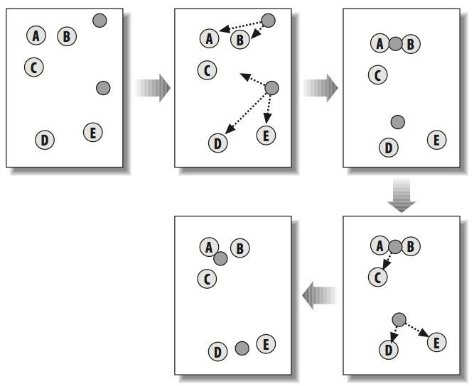

Slide 22
K-means Clustering
def kcluster(rows, distance=pearson, k=4): # Determine the minimum and maximum values for each point ranges = [(min([row[i] for row in rows]), max([row[i] for row in rows])) for i in range(len(rows[0]))] # Create k randomly placed centroids clusters = [[random.random() * (ranges[i][1] - ranges[i][0]) + ranges[i][0] for i in range(len(rows[0]))] for j in range(k)]

Slide 23
K-means Clustering
lastmatches = None for t in range(100): print('Iteration %d' % t) bestmatches = [[] for i in range(k)] # Find which centroid is the closest for each row for j in range(len(rows)): row = rows[j] bestmatch = 0 for i in range(k): d = distance(clusters[i], row) if d < distance(clusters[bestmatch], row):
bestmatch = i bestmatches[bestmatch].append(j)
End loop
End loop

Slide 24
K-means Clustering
# If the results are the same as last time, this is complete if bestmatches == lastmatches:
break lastmatches = bestmatches # Move the centroids to the average of their members for i in range(k): avgs = [0] * len(rows[0]) if len(bestmatches[i]) > 0: for rowid in bestmatches[i]: for m in range(len(rows[rowid])): avgs[m] += rows[rowid][m] for j in range(len(avgs)): avgs[j] /= len(bestmatches[i]) clusters[i] = avgs return bestmatches
End loop

Slide 25
Play with k-means clustering
import clusters blognames, words, data = clusters.readfile('blogdata.txt') kclust=clusters.kcluster(data,k=10)
print([blognames[r] for r in kclust[0]]) print([blognames[r] for r in kclust[1]])
print(kclust)

